Slide 1



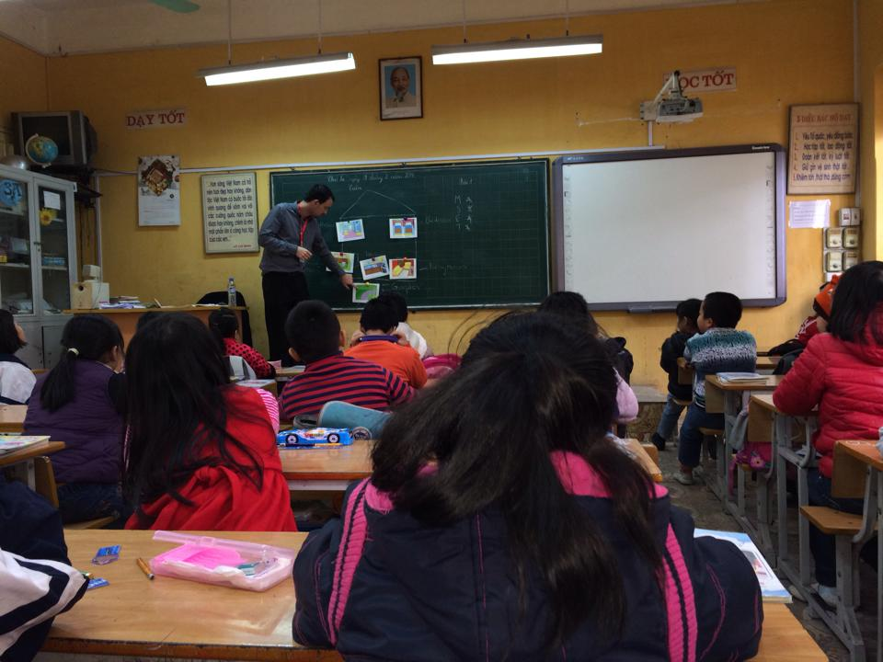





Ai Mo A Primary school
Welcome to our class 3D
Teacher : Cao Thi Dat

Slide 2


Slide 3



Slide 4
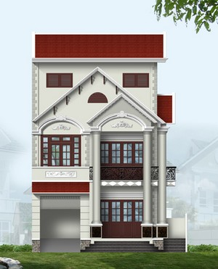

H
O
U
S
E

Slide 5

Thursday February 13th 2014.
Unit 13: My House
Lesson 1: Part 1,2,3 (pages 18,19)
*1. Vocabulary:
House :
ngôi nhà

Slide 6
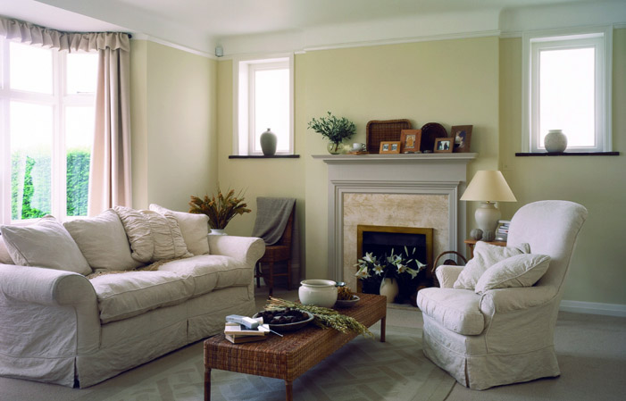
Living room :
phòng khách

Slide 7
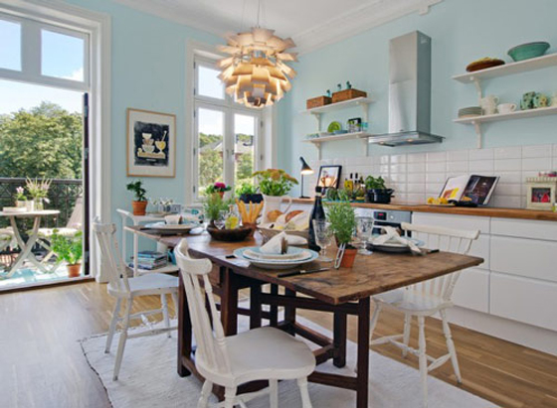
Dining room :
phòng ăn

Slide 8
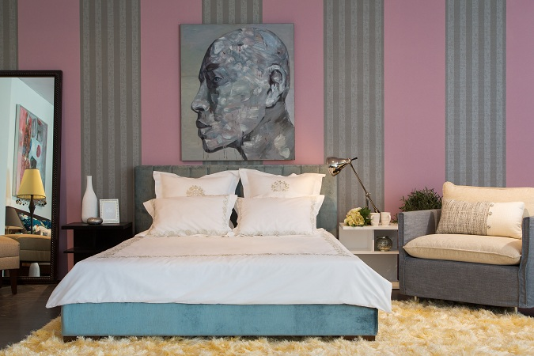
Bedroom :
phòng ngủ

Slide 9
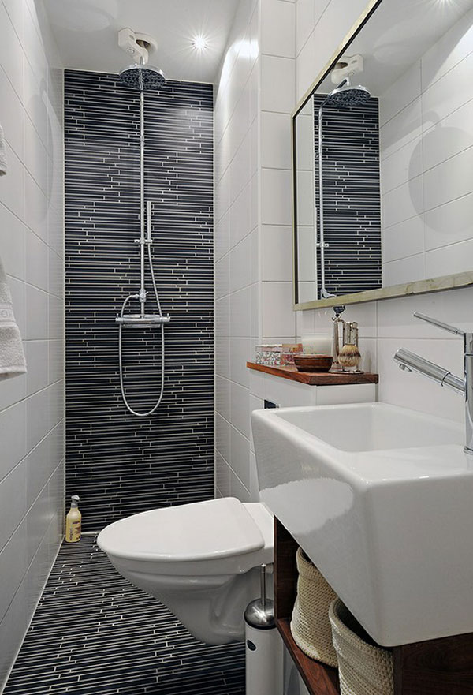
Bathroom :
phòng tắm

Slide 10
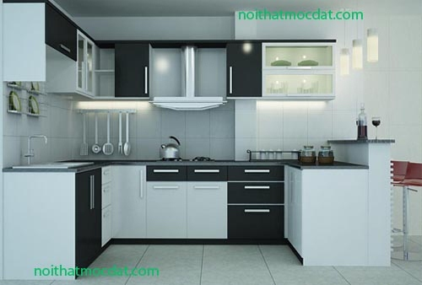
Kitchen :
bếp

Slide 11
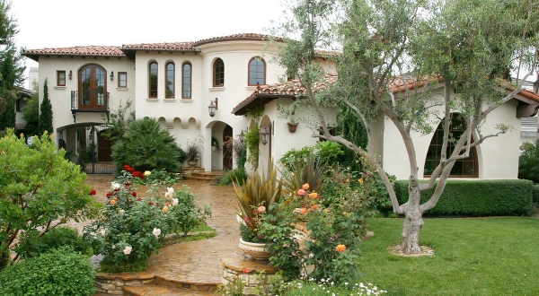
Garden:
vườn

Slide 12
*. Vocabulary:
House
: phòng ăn
Living room
: ngôi nhà
: phòng khách
Dining room
Bedroom
: phòng ngủ
Bathroom
: phòng tắm
Kitchen
: bếp
Garden
: vườn

Slide 13
*. Checking VOC:
: Matching
house
: phòng ăn
living room
: ngôi nhà
: phòng khách
dining room

Slide 14
: bếp
bedroom
bathroom
: vườn
: phòng ngủ
kitchen
: phòng tắm
garden

Slide 15
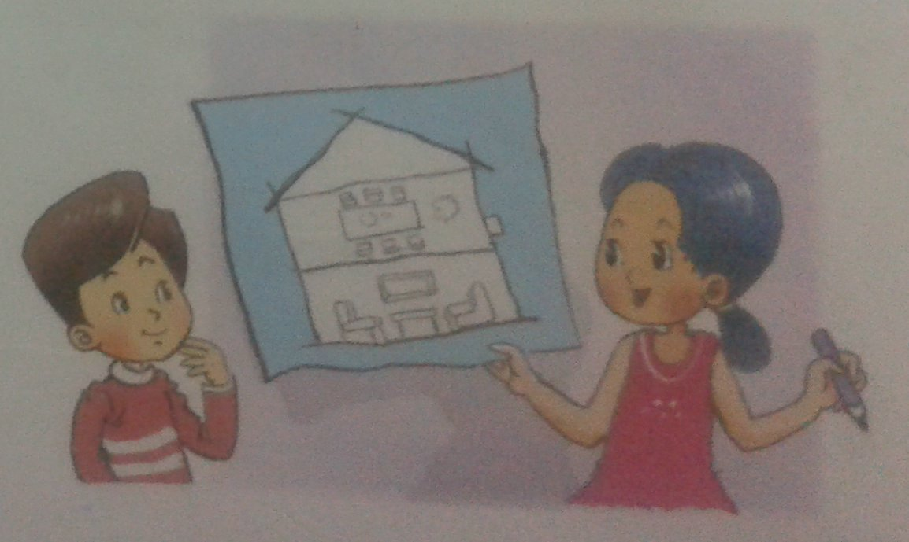
*. Look, listen and repeat:
Mai: This is my house.
Nam: Wow. It’s big.
Mai: There is a living room. There is a dining room.
Nam: Very nice.

Slide 16
2. Sentence Parttern:
This is my house.
This is a dining room.
There is a dining room.

Slide 17

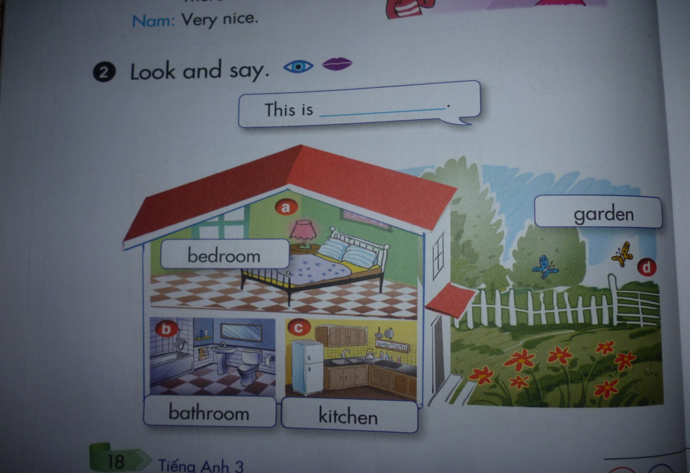
3.Practice :
Look and say
This is ____________.

Slide 18




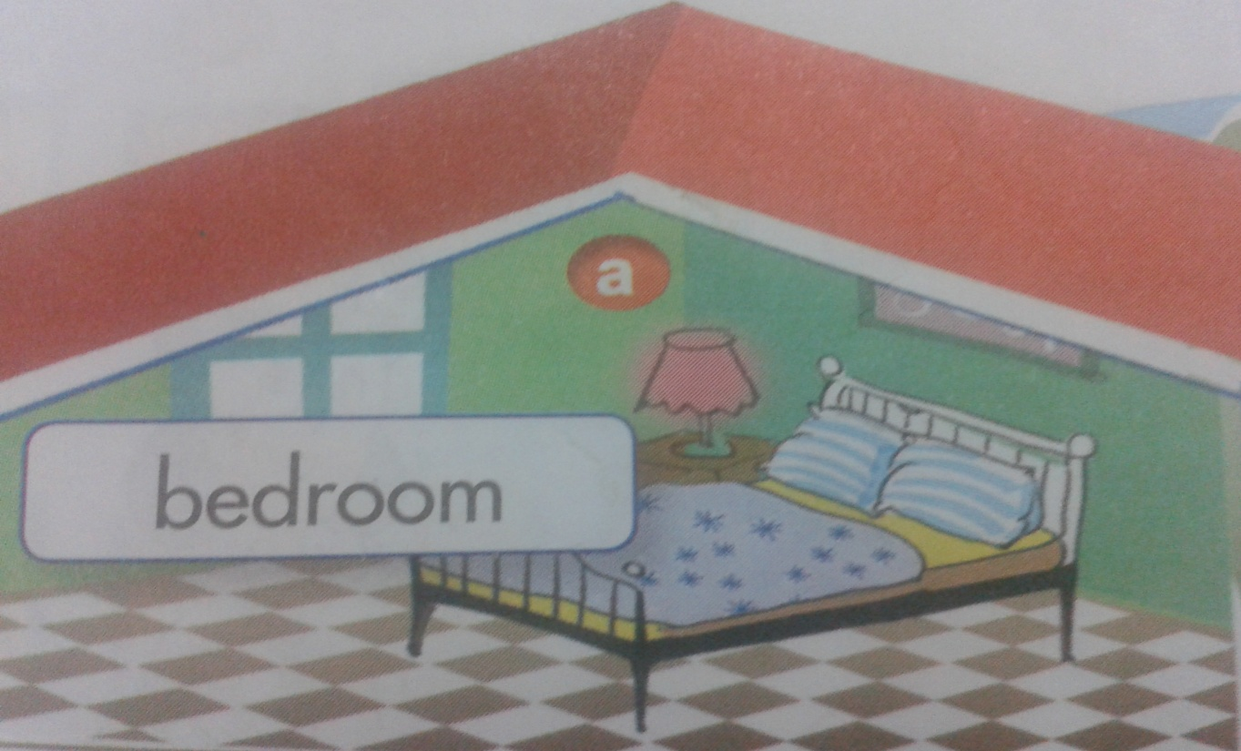


This is
right
a bedroom.

Slide 19
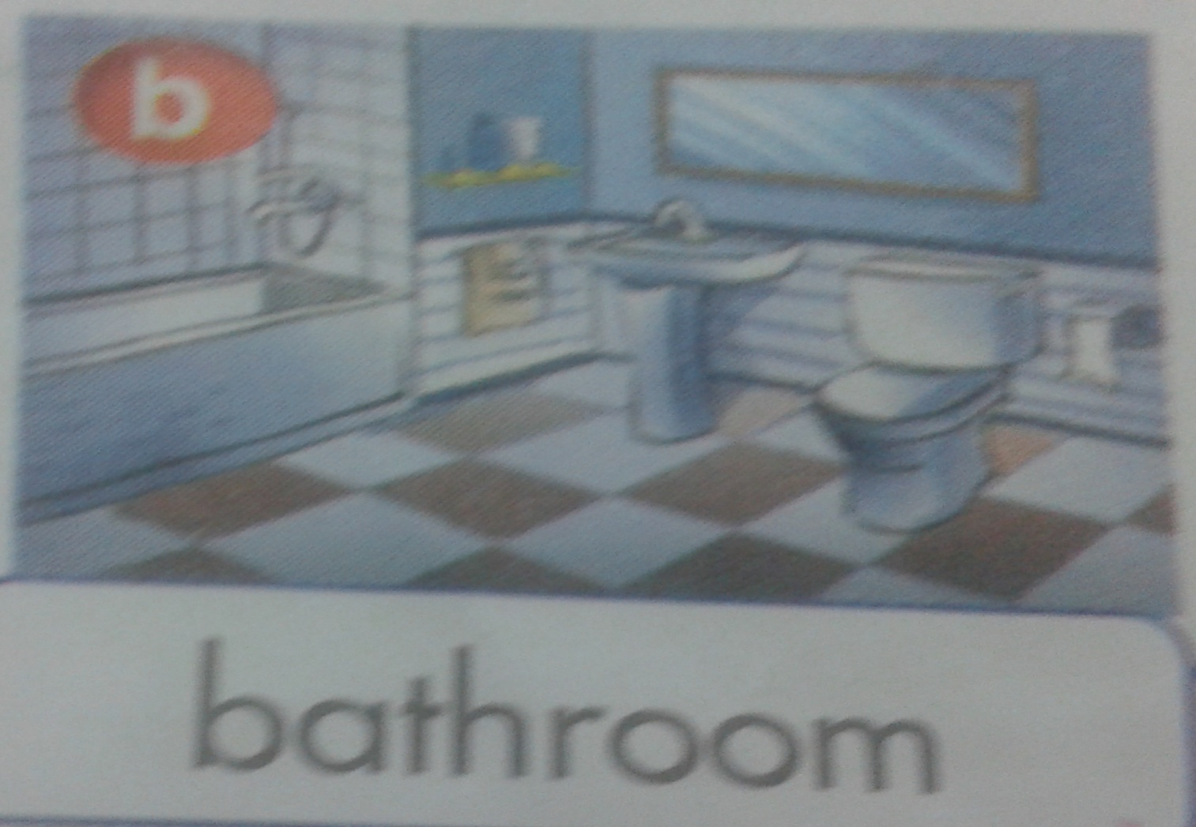
This is
right
a bathroom.

Slide 20
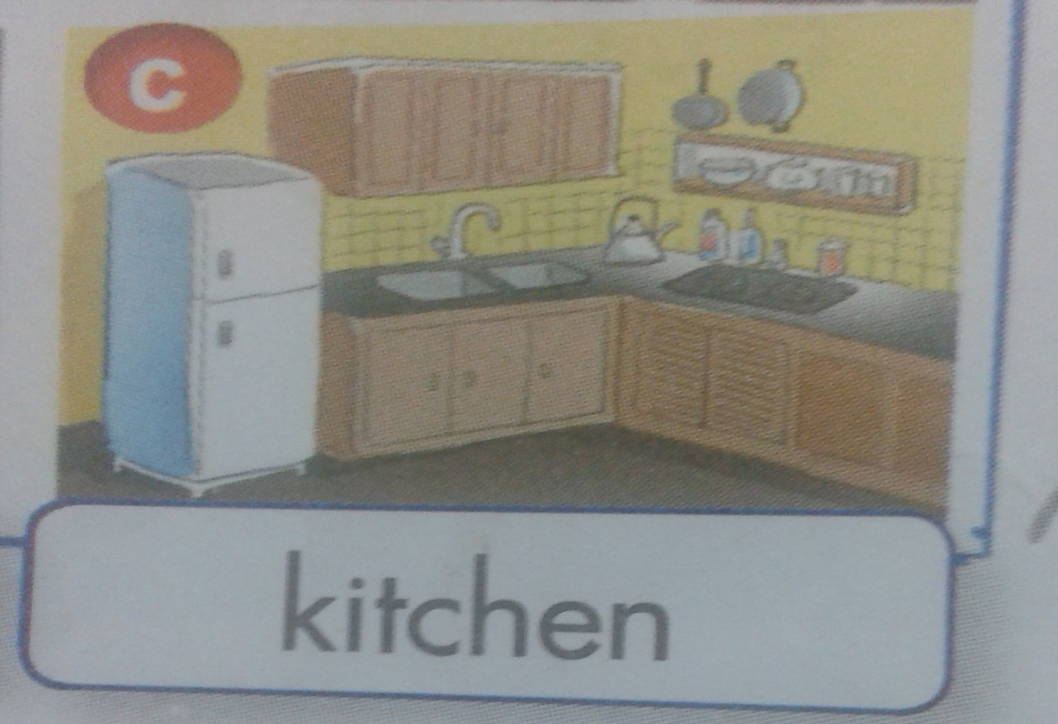
This is
right
a kitchen.

Slide 21
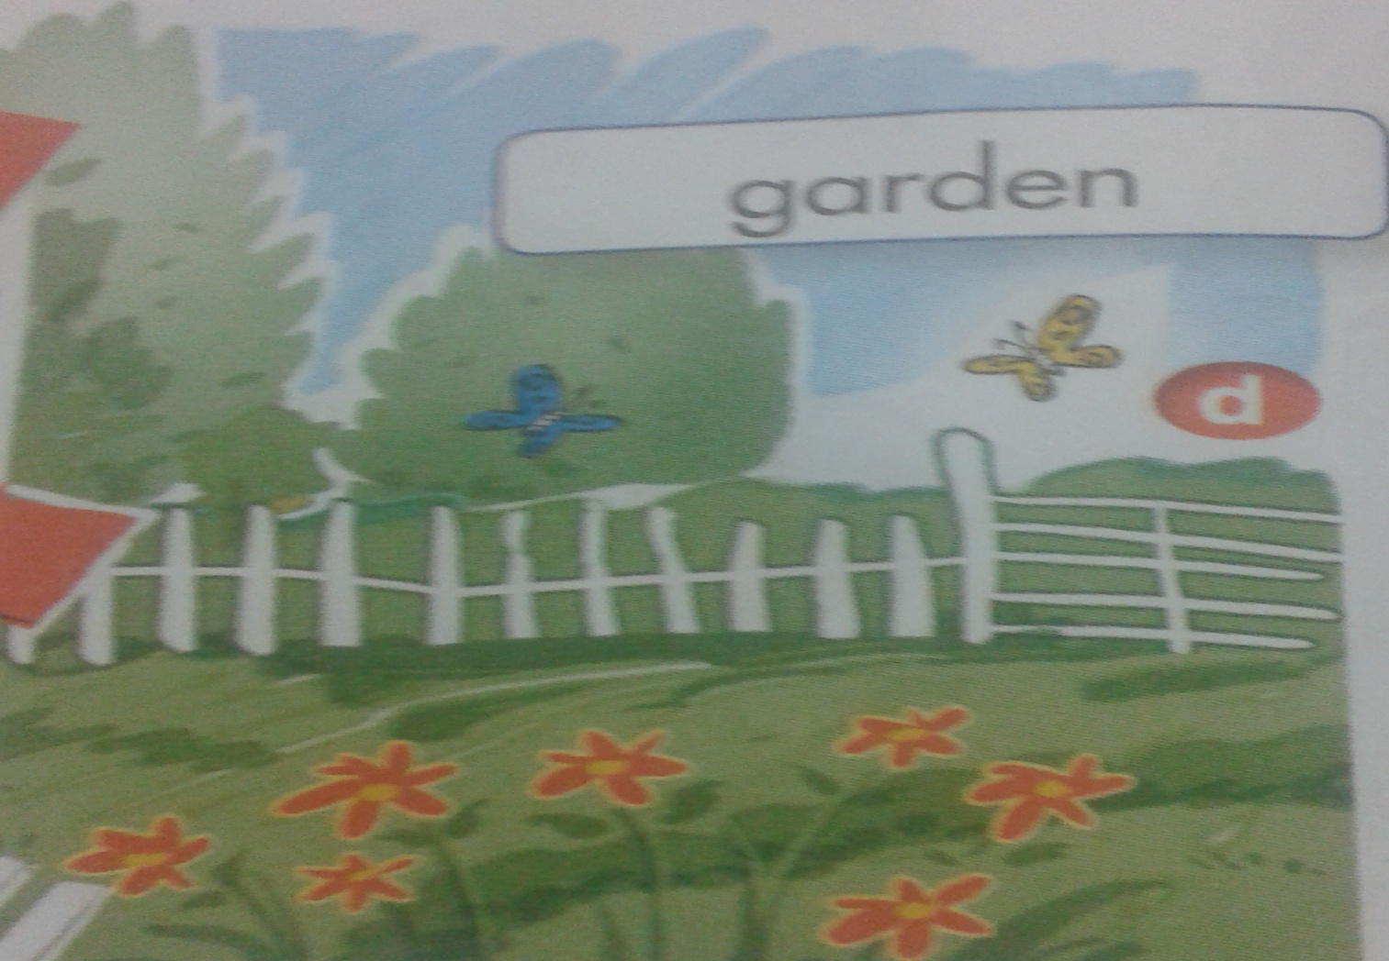
This is
right
a garden.

Slide 22
4. Follow-up

Slide 23










game
Ai thông minh hơn?

Slide 24


Ai thông minh hơn?
Question 1
right
u
ho se
Home

Slide 25
Ai thông minh hơn?
Question 2
right
gar en
d
Home

Slide 26
Ai thông minh hơn?
Question 3
right
Reorder the letters
debmoor =
bedroom
Home

Slide 27
Ai thông minh hơn?
Question 4
right
This is house.
my
A. my B.I C. me
Home

Slide 28
*Homelink:
-Learn by heart the vocabulary and model sentence.
-Write 2 lines/ word and 3 lines/ sentence.

Slide 29



Good bye
Thanks For Your Attention!
Thanks for your attention!

